Slide 1
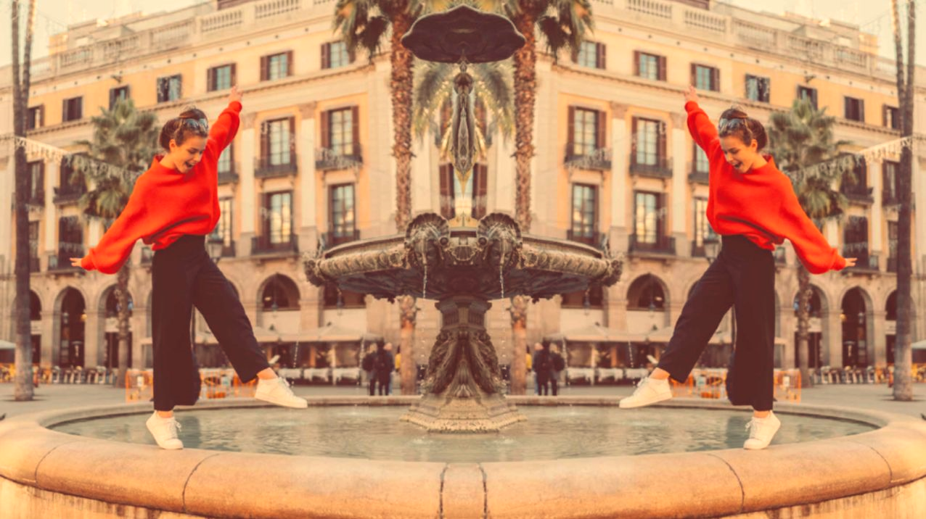
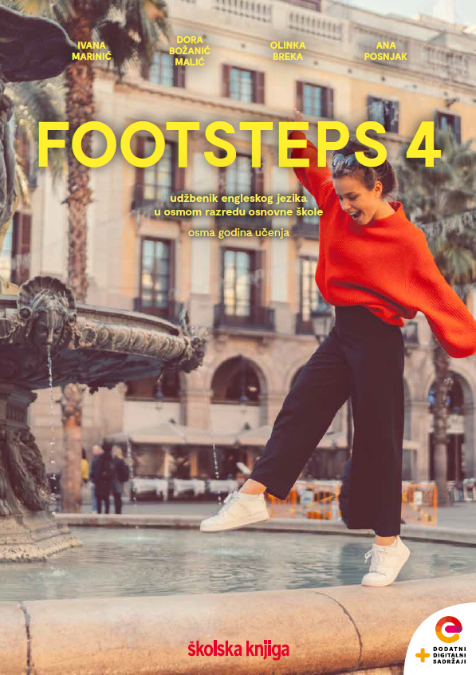

UNIT 6; Lend me your ear
Lesson 2; Lectures

Slide 2
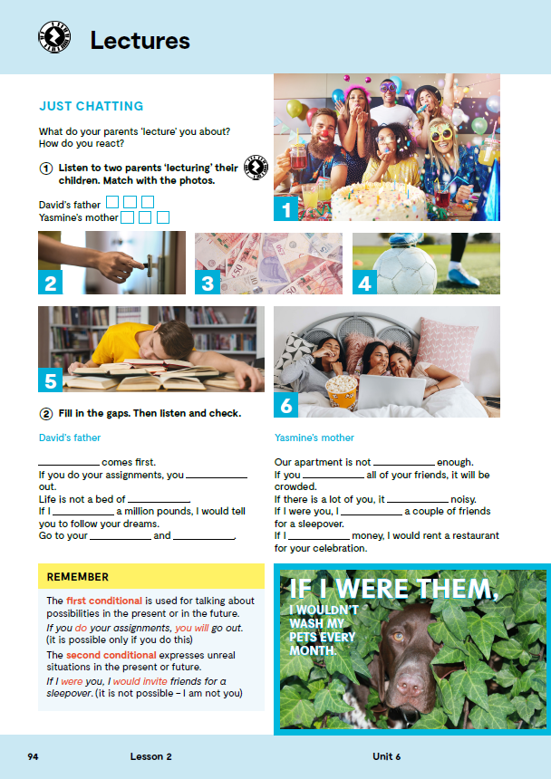
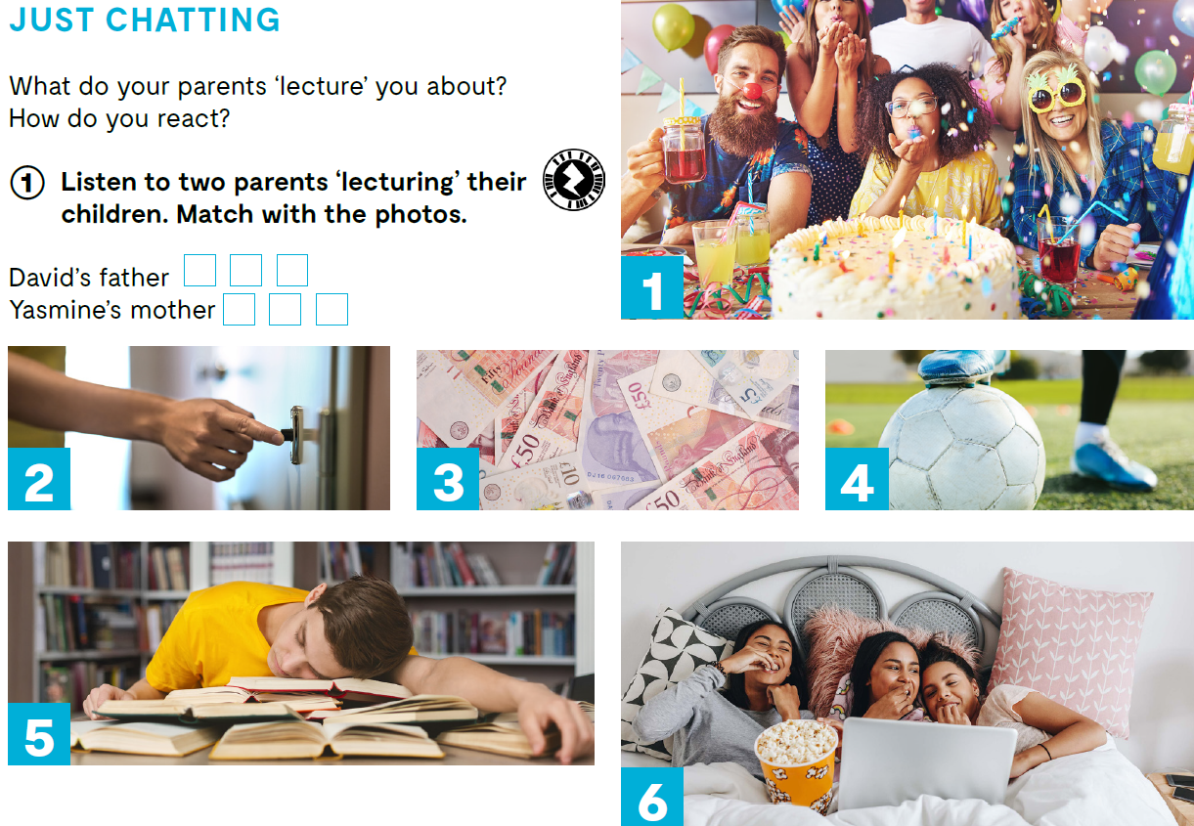

Open your book, page 94.
Match with the photos. https://www.e-sfera.hr/dodatni-digitalni-sadrzaji/f0e232f1-2088-4d07-8c66-a7901dc93c33/assets/audio/22_unit_6__lesson_2__exercises_1_2.mp3
3
4
5
1
6
2

Slide 3

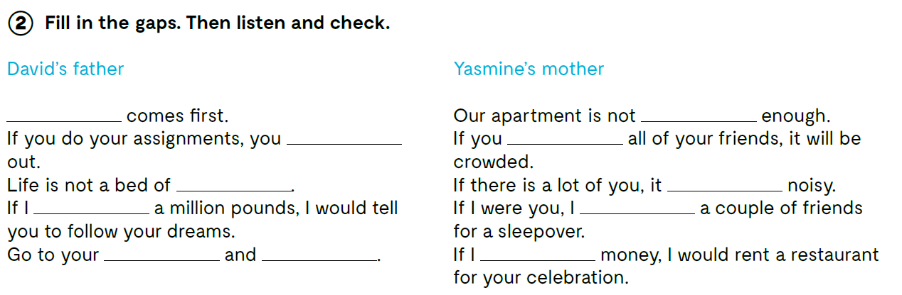
https://www.e-sfera.hr/dodatni-digitalni-sadrzaji/f0e232f1-2088-4d07-8c66-a7901dc93c33/assets/audio/22_unit_6__lesson_2__exercises_1_2.mp3
School
big
‘ll go
invite
roses
will be
had
would invite
room
study
had

Slide 4
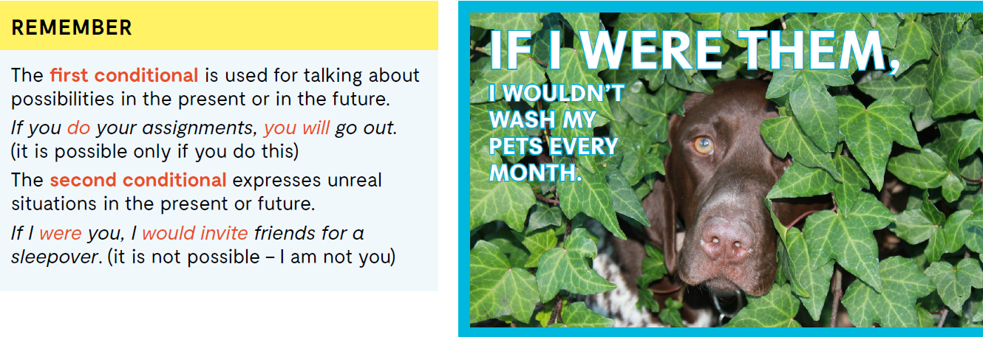

Slide 5
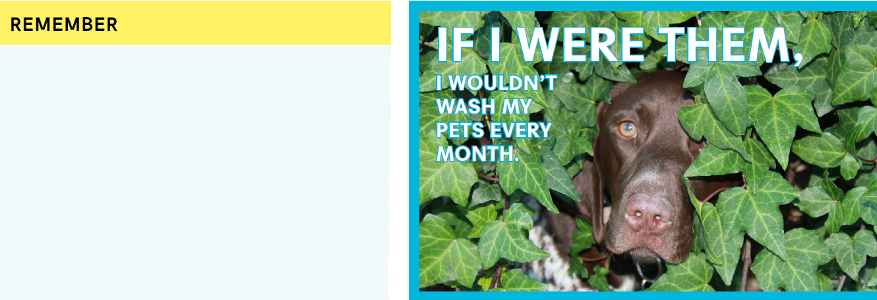
FIRST CONDITIONAL koristimo kada govorimo o situacijama/radnjama koje će se dogoditi u budućnosti, ali koje zavise od ispunjenja nekog uvjeta u bliskoj budućnosti. If you do your assignments, you will go out. - if rečenica (PRESENT SIMPLE) + glavna rečenica (WILL + glagol)
SECOND CONDITIONAL koristimo kada je mogućnost ispunjenja uvjeta mala. Koristimo ga kako bi pričali o hipotetičkim/nemogućim situacijama. If I were you, I would invite friends for a sleepover. - if rečenica (PAST SIMPLE) + glavna rečenica (WOULD + glagol)

Slide 6
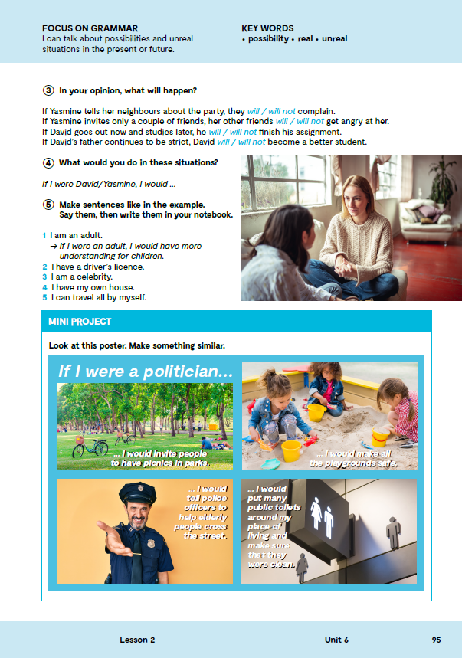
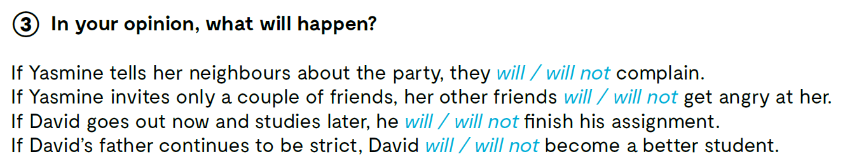
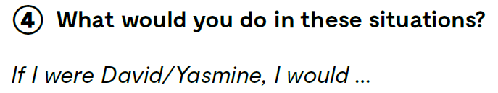

Slide 7
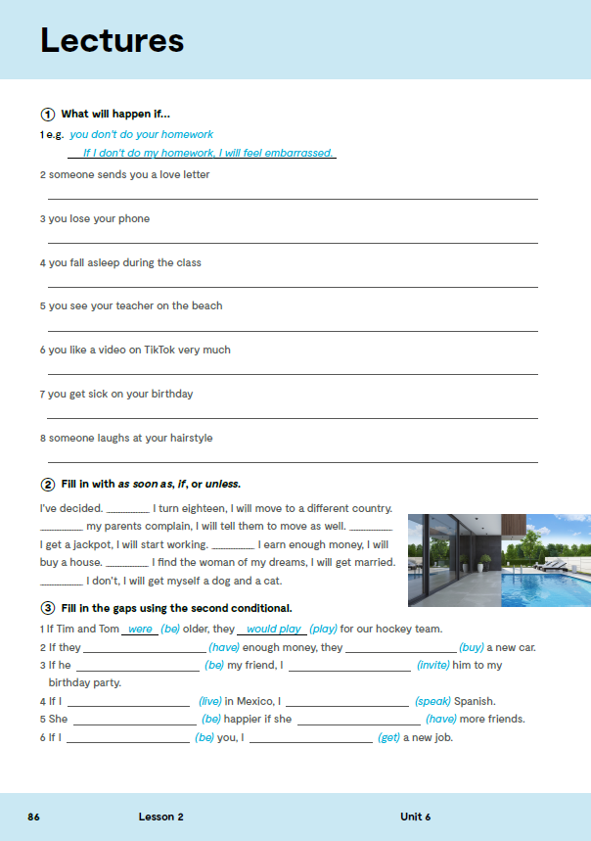
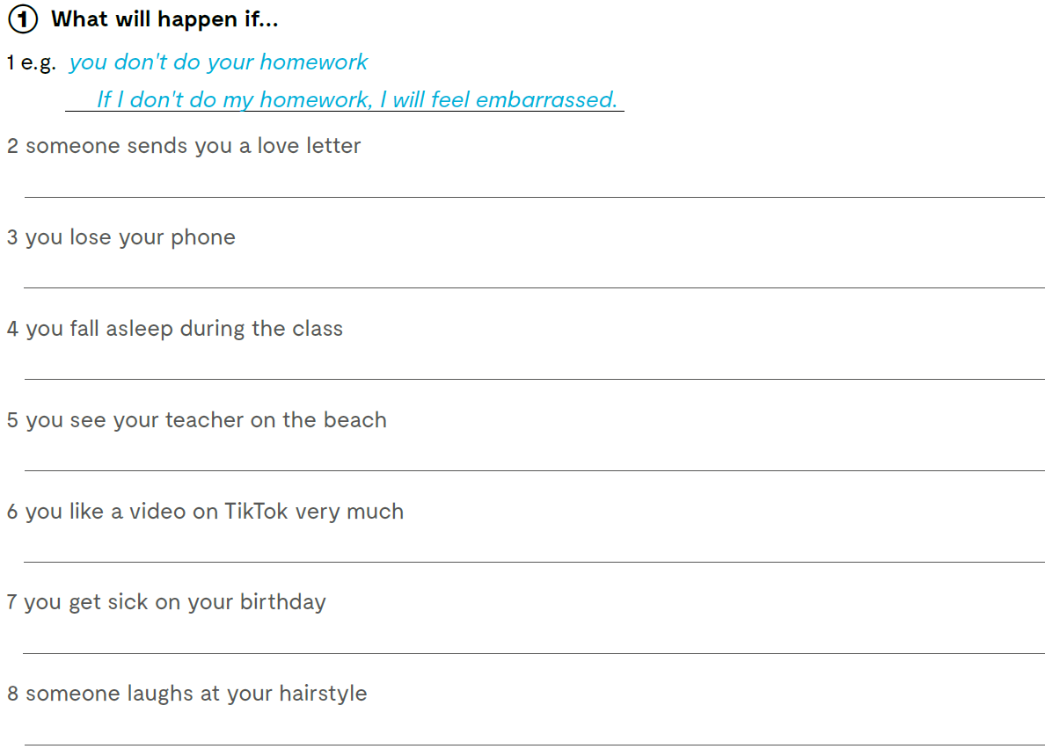
Workbook, page 86.
Check what you have learnt. https://wordwall.net/play/13268/243/786
https://wordwall.net/play/13268/598/448

Slide 8
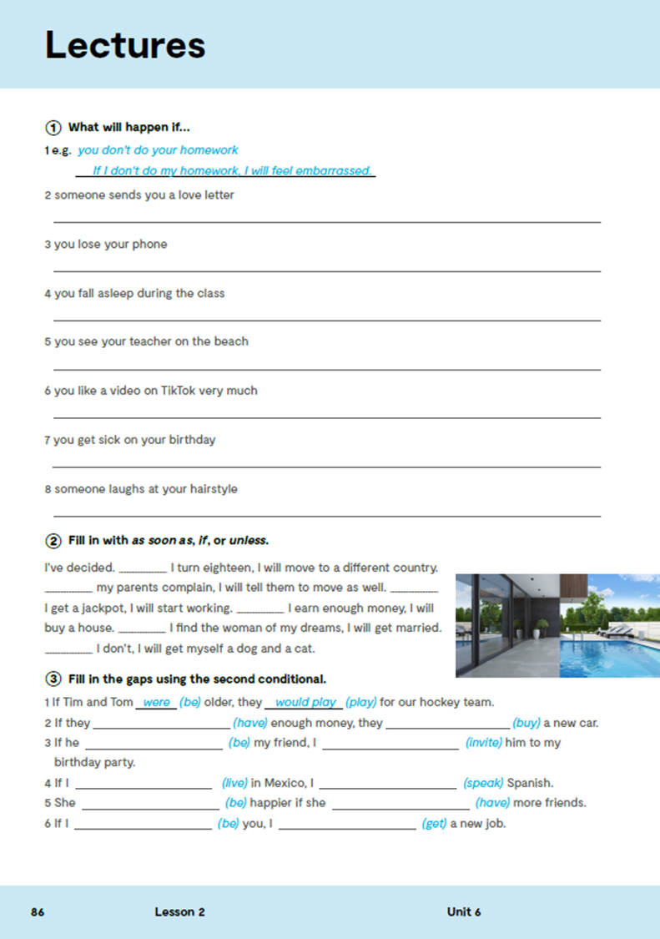
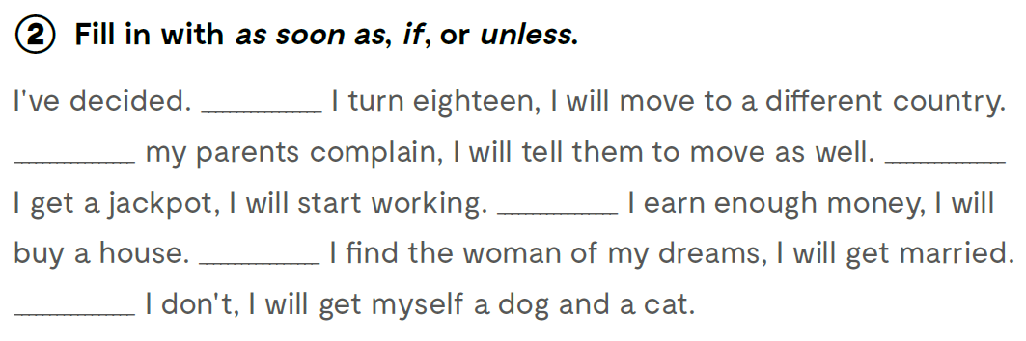
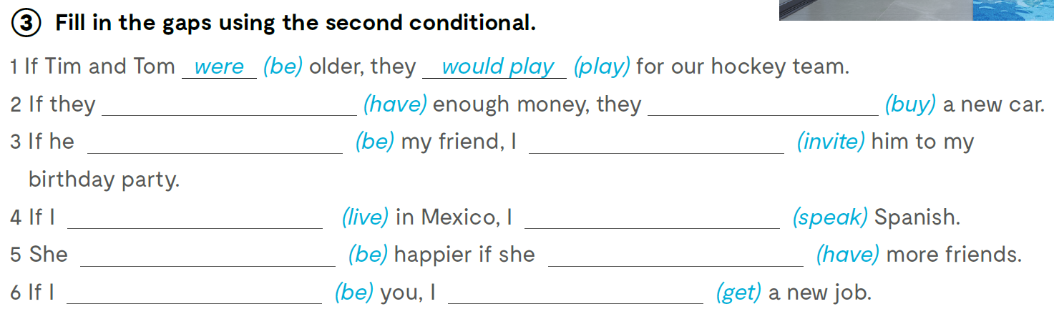
As soon as
If
Unless
As soon as
If
If
had
would buy
were
would invite
lived
would speak
would be
had
were
would get

Slide 9
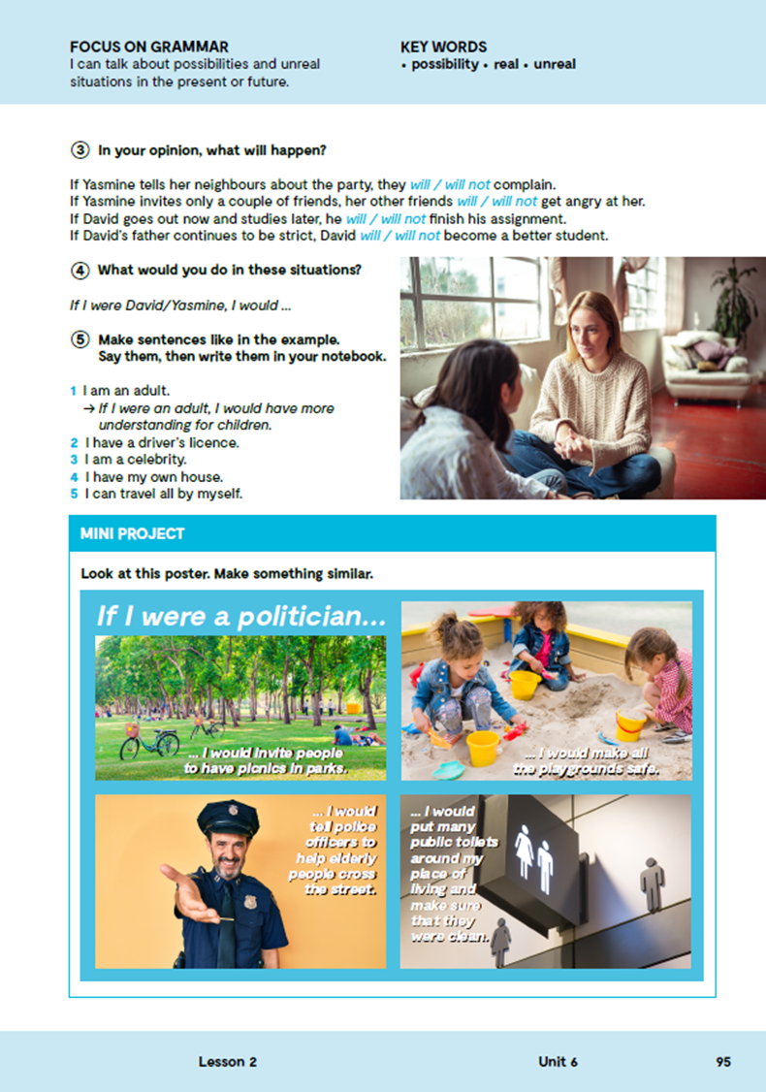
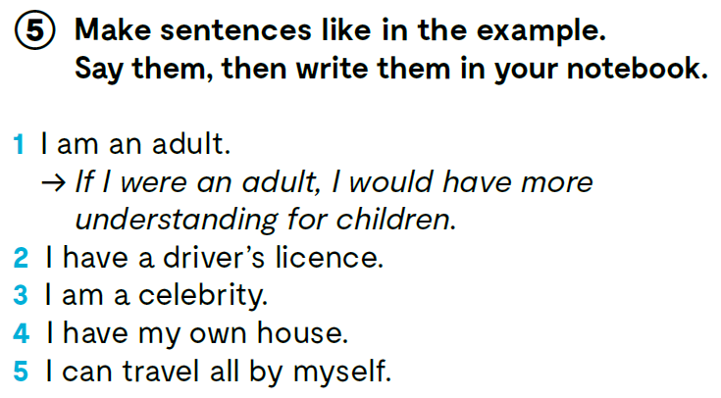

Slide 10

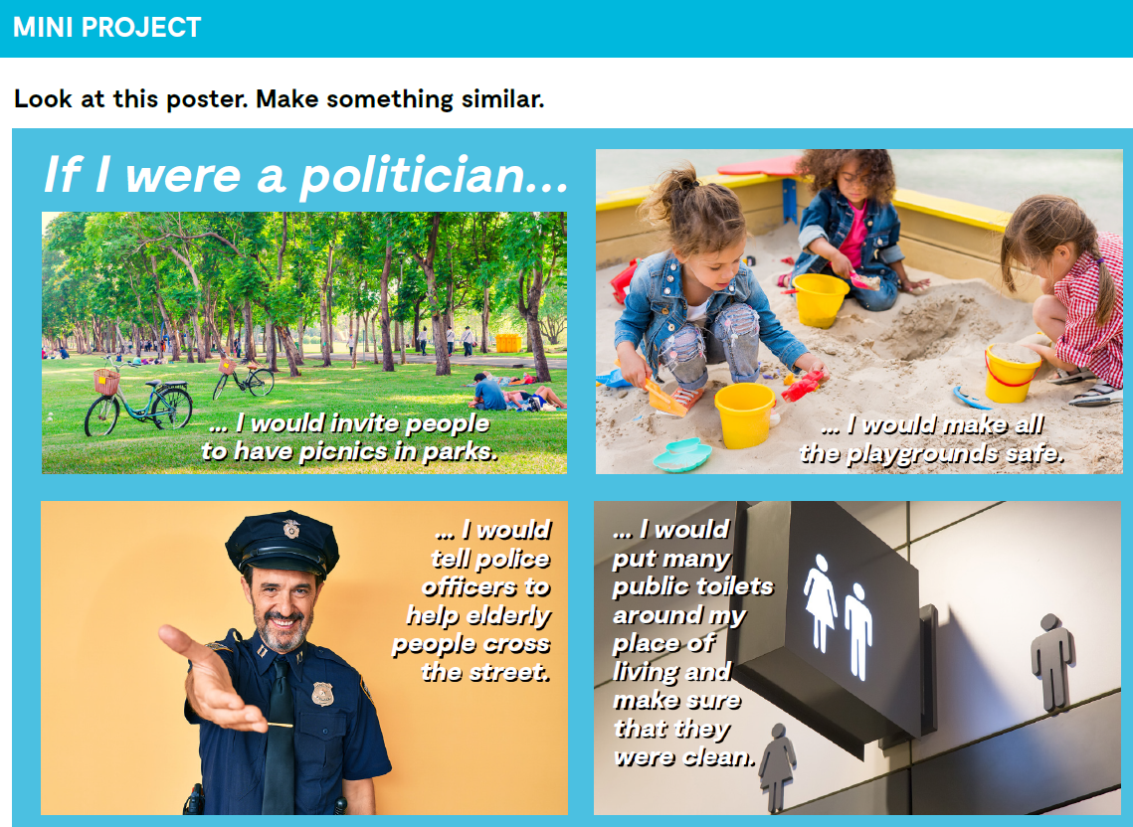

Slide 11
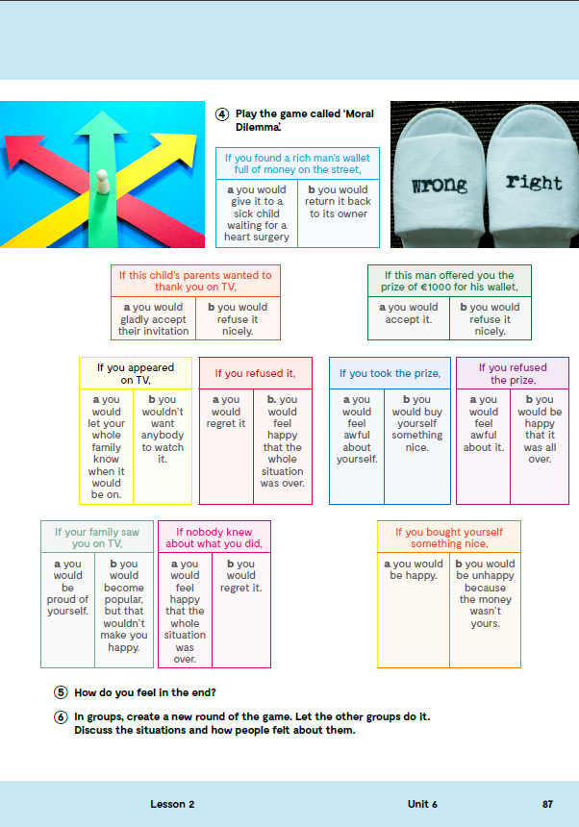
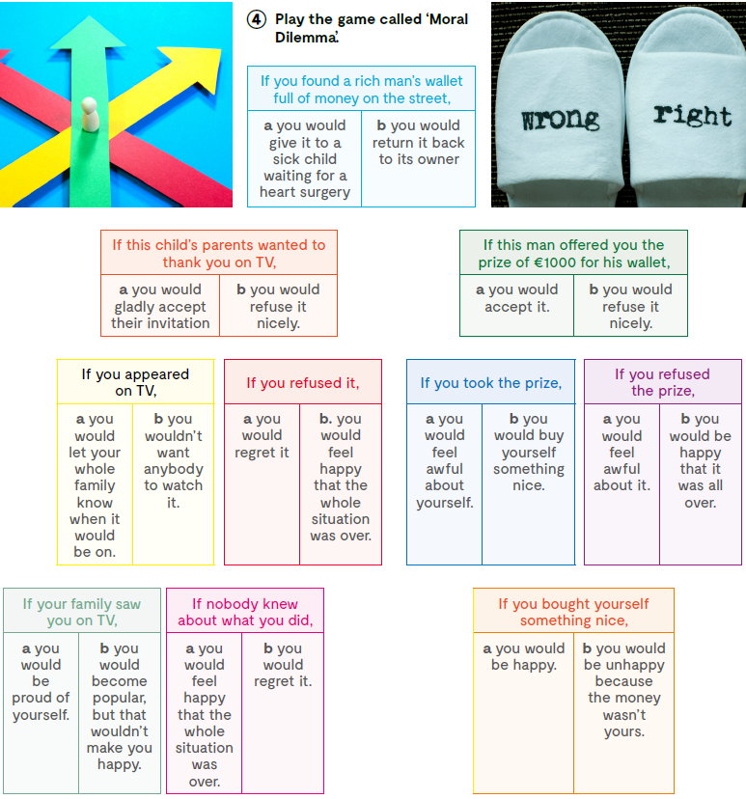

Open your exercise book, page 87.
Play the game ‘Moral Dilemma’.

